Slide 1
Chapter 4
TrustZone Hardware Library
107/03/16

Slide 2
Overview
4.1 System IP
4.2 Processor IP
4.3 Reuse of AMBA2 AHB IP
107/03/16

Slide 3
4.1 System IP
In-built support for the Security Extensions
PrimeCell® High-Performance Matrix-PL301
Provide AMBA3 AXI compliant bus matrix- connects components together.
PrimeCell Infrastructure AMBA3 AXI to APB Bridge - BP135
Access for up to 16 peripherals on local APB bus.
Includes a single TZPCDECPROT input signal for each peripheral.
Reject Non-secure transactions to Secure peripheral address ranges.
107/03/16

Slide 4
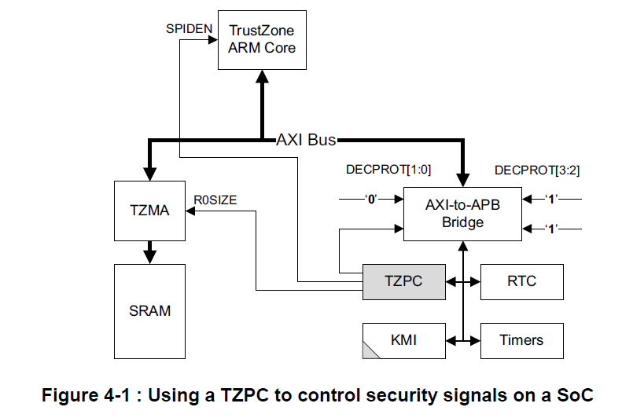
4.1 System IP
AXI-to-APB bridge controlling 4 peripherals.
TZPC(TrustZone Protection Controller) is always secure and allow dynamic security switching at run-time.
RTC(rear time clock) and Timers: non-secure.
KMI(keyboard and mouse interface): programmable security under software control.
SPIDEN debug control input
TrustZone memory adapter
Static Random Access Memory
107/03/16

Slide 5
4.1 System IP
PrimeCell Infrastructure AMBA3 AXI to AMBA 2 AHB Bridge - BP136-7
AXI-to-AHB and AHB-to-AXI bridges allow two systems joined together.
AHB bus does not carry the security state of the memory transactions.
All of the security implementation must be managed in the bridge itself.
Secure components and Non-secure components are never placed behind the same bridge.
107/03/16

Slide 6
4.1 System IP
PrimeCell Level 2 Cache Controller - PL310.
A level 2 cache is between the core and the external memory system.
Reduce the number of processor pipeline stalls experienced.
Fast performance and reducing power consumption.
ARM1176JZ(F)-S and Cortex-A9 processors use a separate level 2 cache controller.
PrimeCell DMA Controller - PL330.
DMAC(direct memory access controller): a dedicated engine for moving data around the physical memory system.
Support concurrent Secure and Non-secure channels.
A Non-secure transaction to or from Secure memory will result in the DMA transfer failing.
107/03/16

Slide 7
4.1 System IP
PrimeCell TrustZone Address Space Controller(TZASC) - PL380
TZASC: programmed by secure software and will reject non-secure transaction to secure region.
Partition an off-SoC DRAM into multiple security domains.
Less expensive than placing two smaller memory devices.
Designed to work with dynamic memory and allows burst accesses to travel through it with minimal impact on memory latencies.
Only be used for partitioning memory mapped devices.
107/03/16

Slide 8
4.1 System IP
PrimeCell Infrastructure AMBA3 AXI TrustZone Memory Adapter(TZMA) - BP141
Secure a region within an on-SoC static memory such as a ROM or a SRAM.
Allow a single static memory of up to 2MB to be partitioned into two regions.(lower part: Secure; upper part: Non-secure.
Use R0SIZE input signal to the TZMA.
PrimeCell Generic Interrupt Controller(GIC) - PL390
Interrupt controller must prevent the Normal world modifying the Secure world interrupt sources.
GIC is a single hardware device that supports both Secure and Non-secure prioritized interrupt sources.
Prevent non-secure software modifies secure source.
107/03/16

Slide 9
4.1 System IP
PrimeCell Infrastructure AMBA3 TrustZone Protection Controller(TZPC) - BP147
A configurable signal control block which can be placed on the APB bus to supply control signals to other components on the SoC.
TZPCDECPROT{2:0} register: control 8 signals within the SoC.
TZPCR0SIZE register: provide the partition location control signals for the TrustZone Memory Adapter.
107/03/16

Slide 10
4.2 Processor IP
ARM1176JZ(F)-S processor
Cortex-A8 processor.
Cortex-A9 processor and Cortex-A9 MPCore processor
ARM1156T2(F)-S™ processor
Cortex-R4 processor
SecurCore smartcard processors
ARM SecurCore family member.
Higher level of physical security than a TrustZone system.
TrustZone system can provide functionality that the smartcard cannot.
107/03/16
Notes:
主要原理是：AXI總線上每個讀寫信道都增加了一個額外的控制信號

Slide 11
4.2 Processor IP
Summary of processor features:
SC100: Supports ARM and Thumb instruction sets.
SC200: Supports ARM and Thumb instruction sets and integrated Jazelle™ technology for accelerating Java Card applications.
SC300: supports multiple technologies, includes Thumb-2 instruction set, reducing memory requirements and increasing software performance.
.
107/03/16
Notes:
主要原理是：AXI總線上每個讀寫信道都增加了一個額外的控制信號

Slide 12
4.3 Reuse of AMBA2 AHB IP
Reuse of AHB masters
AHB: advanced hardware bus.
Must connect to the AXI domain through an AHB-to-AXI bridge.
Only possible to directly address 4GB of physical memory per AHB master.
Not possible to address the full 8GB of the Secure and Non-secure physical address space in one AHB master’s memory map.
Reuse of AHB slaves
Separate AHB buses are used to contain the Secure and the Non-secure AHB slaves.
Use single NS-bit control signal to deny any transactions which have invalid security permissions.
107/03/16

Slide 13
Chapter 5
TrustZone Software Architecture
107/03/16

Slide 14
Outline
5.1 Software overview
5.2 Booting a secure system
5.3 Monitor mode software
5.4 Secure software and
multiprocessor systems
5.5 The TrustZone API
107/03/16

Slide 15
5.1 Software overview
Secure world processing resources
The software architecture will be heavily influenced by the available Secure world processing resource.
The software running on the Secure world processor must be self contained and provides its own local operating environment.
A TrustZone-enabled processor will give the Secure world higher software performance and requires less silicon area than a dedicated security processor.
Software architecture
The most complexed is a dedicated Secure world operating system.
The simplest is a synchronous library of code placed in the Secure world.
107/05/04
Notes:
支持trustzone的ARM處理器的協處理器CP15有個安全配置寄存器（SCR），該寄存器有個NS位，這個NS位指明當前系統狀態。
如果NS=0，系統處於安全狀態，NS=1，系統處於非安全狀態。

Slide 16
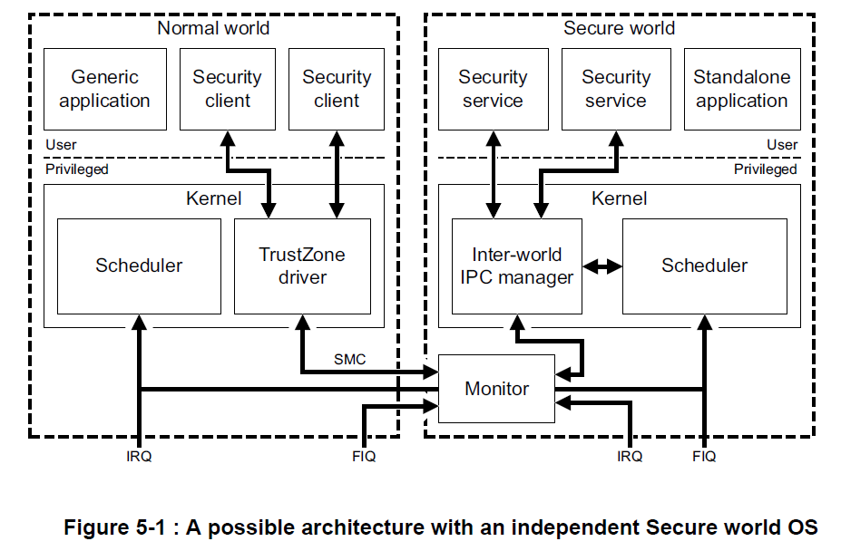
5.1 Software overview
Secure operating system
A dedicated operating system is complexed, but powerful.
Two separate physical processors in a SoC.
The software running on each virtual processor is a standalone operating system.
Uses a communications protocol to associate Secure world tasks with the Normal world thread.
107/05/04
Notes:
支持trustzone的ARM處理器的協處理器CP15有個安全配置寄存器（SCR），該寄存器有個NS位，這個NS位指明當前系統狀態。
如果NS=0，系統處於安全狀態，NS=1，系統處於非安全狀態。

Slide 17
5.1 Software overview
Secure operating system
This design enables real-time response and is good for media applications.
Use MMU to separate the Secure world memory space into multiple user-space sandboxes.
The kernel can enforce the logical isolation of secure tasks to avoid memory space tampered.
107/05/04
Notes:
支持trustzone的ARM處理器的協處理器CP15有個安全配置寄存器（SCR），該寄存器有個NS位，這個NS位指明當前系統狀態。
如果NS=0，系統處於安全狀態，NS=1，系統處於非安全狀態。

Slide 18
5.1 Software overview
Synchronous library
A simple library of code in the Secure world which can handle one task at a time is sufficient for many applications.
This code library is entirely scheduled and managed using software calls from the Normal world operating system.
Intermediate options
Use a virtual interrupt in the Normal world.
Vulnerable to a denial-of-service attack if the Normal world operating system stopped providing the virtual interrupt.
For many cases, this is not a problematic attack.
107/05/04
Notes:
支持trustzone的ARM處理器的協處理器CP15有個安全配置寄存器（SCR），該寄存器有個NS位，這個NS位指明當前系統狀態。
如果NS=0，系統處於安全狀態，NS=1，系統處於非安全狀態。

Slide 19
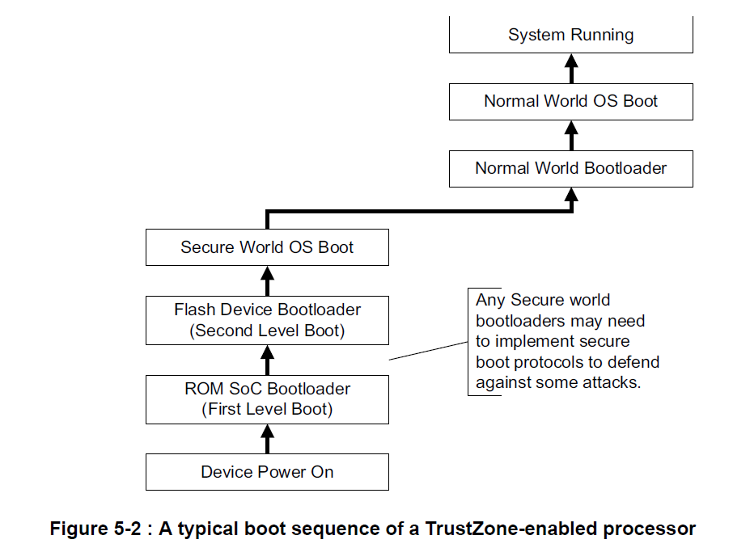
5.2 Booting a secure system
Boot sequence
Attackers can break the software while the device is powered down, replace the Secure world software image in flash.
Use a chain of trust for all Secure world software, and a root of trust in normal world software to avoid being tampered with.
107/03/16

Slide 20
5.2 Booting a secure system
Boot sequence
A TrustZone-enabled processor starts in the Secure world when it is powered on.
Enables any sensitive security checks to run before the Normal world software has an opportunity to modify any aspect of the system.
107/03/16

Slide 21
5.2 Booting a secure system
Boot sequence
System control coprocessor lockdown
Provide additional protection for the system.(unmodifiable)
Use CP15SDISABLE processor input signal to lock-down some of the critical Secure world configuration options in CP15.
107/03/16

Slide 22
5.2 Booting a secure system
Secure boot
Cryptographic signature protocol
Cryptographic checks in Secure world boot process to assert the integrity of all of the Secure world software images that are executed.
Preventing any unauthorized or maliciously modified software from running.
The most logical cryptographic protocol to apply is a public-key signature algorithm, such as RSA.
Vendor uses their Private Key (PrK) to generate a signature of the code.
The PuK(public keys) in this signature protocol cannot be replaced by attackers.
107/03/16

Slide 23
5.2 Booting a secure system
Secure boot
Chain of trust
The secure boot process implements a chain of trust.
Every component can be authenticated before being executed.
Also known as the root of trust, must be located in the on-SoC ROM.
Use On-SoC One-Time-Programmable(OTP) hardware to risk of class break attacks.
On-SoC Secure world or Off-SoC Secure world
The simplest defense against shack attacks is to keep Secure world resource execution located in on-SoC memory locations.
Difficult to snoop or modify data values.
107/03/16

Slide 24
5.3 Monitor mode software
Provide a robust gatekeeper and manages the switches between the Secure and Non-secure processor.
Context switching
Hardware exceptions: IRQ, FIQ, external abort.
A full context switch of all state is required.
Software exception: SMC
Efficient software communications protocols can be built between the two worlds using SMC initiated context switches and World-shared memory.
Lazy context switching
Allows the context of the coprocessor to be saved only when necessary.
Decrease average switch overheads.
107/03/16
Notes:
VIVT 指的是 Virtual Indexed Virtual Tagged
Tightly Coupled Memories 耦合記憶體(TCM)

Slide 25
5.3 Monitor mode software
Interrupt model - monitor requirements
IRQ is configured as a Normal world interrupt.
FIQ is configured as a Secure world interrupt.
The Secure Configuration Register (SCR) in CP15 determines whether to trap IRQ, FIQ or external aborts to the monitor hardware.
Interrupt latency impact
The monitor defines the system’s worst case interrupt latency and make sure it does not cause violation of any timing constraints.
Place the monitor in fast memory close to the core to minimize the interrupt latency impact.
107/03/16
Notes:
VIVT 指的是 Virtual Indexed Virtual Tagged
Tightly Coupled Memories 耦合記憶體(TCM)

Slide 26
5.4 Secure software and
multiprocessor systems
Secure world processor affinity
Fix the Secure world execution on to one specific processor will make Secure interrupt routing simple.
107/03/16

Slide 27
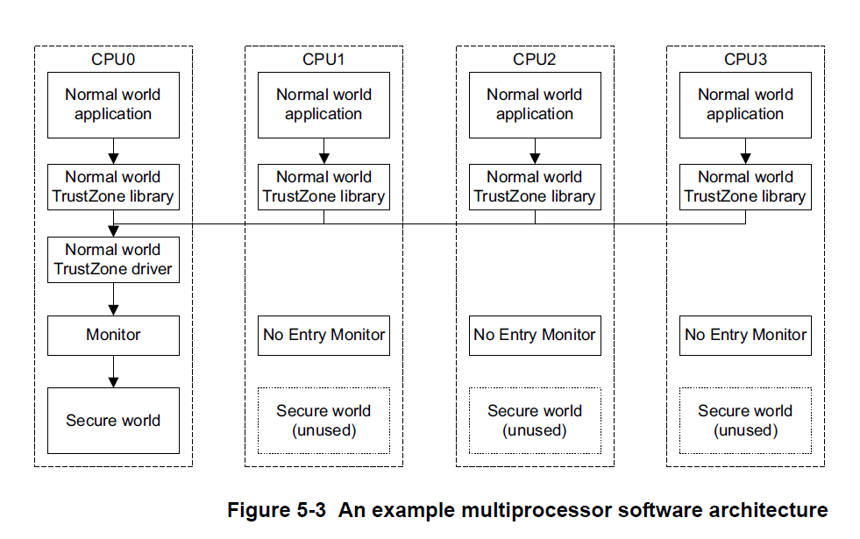
5.4 Secure software and
multiprocessor systems
Secure world processor affinity
One specific processor will make Secure interrupt routing simple.
The Secure world software is only using CPU0.
The Secure world only executing on one processor at any single point in time.
The Secure interrupts routing to the necessary processor are more complicated.
107/03/16

Slide 28
5.4 Secure software and
multiprocessor systems
Secure world interrupt usage
The Secure world uses the SMP processor to integrate Secure interrupt sources.
Must ensure that the Secure Configuration Register (SCR)in CP15 is appropriately programmed.
107/03/16

Slide 29
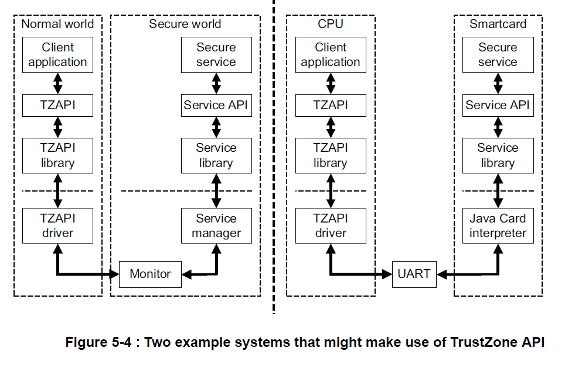
5.5 The TrustZone API
ARM have produced a standardized software API, called the TrustZone API (TZAPI).
Communications API:
Eenables a client to send command requests to a security service and efficiently exchange data.
Allow normal world client applications to authenticate themselves with a secure service.
107/03/16
Notes:
CP15– 系統控制協外處理器 coprocessor ， 有個安全配置寄存器SCR

Slide 30
5.5 The TrustZone API
The TrustZone API is targeted at systems using a TrustZone-enabled processor.
Smartcard would also be a suitable candidate for an implementation of TrustZone API.
API availability
ARM has released the TrustZone API as a public specification.
Can be downloaded and used free of charge.
107/03/16
Notes:
CP15– 系統控制協外處理器 coprocessor ， 有個安全配置寄存器SCR

Slide 31
THANK YOU
107/03/16

